Slide 1
Modbus testing procedure

Slide 2
Modbus testing Procedure
Prerequisite
Modscan software
RS485 to USB convertor with driver installed in computer
Modbus device (address list)
Procedure
Set the computer port as same as Modbus device and note the port number (from device manager0
Open Modscan software
Connect Modscan with device
Set the port as noted at step ‘1’
Configure the setting as same as Modbus device
Set the device ID and register address based on Modbus manual
Monitor the value and response value

Slide 3
1) Go to Control Panel to check the port number and configuration

Slide 4
2) Go to device manager

Slide 5
3) Right Click on USB

Slide 6
4) Check the configuration and take note the port number

Slide 7
6) Open ModScan12

Slide 8
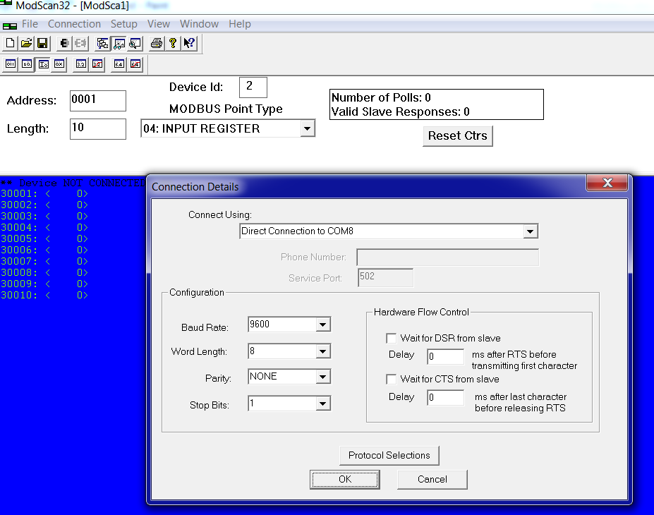
7) Initiate the connect
This setting must be as same as Modbus device and port configuration

Slide 9
7) Set Device ID, Point type and Register address
Register address from 30001 to 20020 (this information will get form Modbus device manufacturer
Device ID is ‘1’
This number will increase once communication is up
Point type
The value could be absolved

Slide 10
8) Set Device ID, Point type and address and check the com status

